Slide 1
CoTaPP: Computational Thinking and Programming with Python
Module 1: Computational Thinking
9 February 2022

Slide 2
Course Administration
Lecturers:
Pablo Mosteiro (Wednesdays)
Isaac Alpizar-Chacon (Fridays)
Lab coordinator: Francisca Pessanha
Lab instructors:
Alec Noppe (lab A – BOL 1.075)
Stefan Stan (lab B – BOL 1.082)
Nathan Oerlemans (lab C – BOL 3.100)
Selim Buyuk (lab D – BOL 0.204)
Guanyi Chen (lab E – online)

Slide 3

Course Structure
Lectures (2 per week)

Slide 4
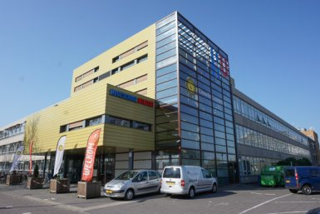
Course Structure
Lectures (2 per week)
Laboratories (1 per week)

Slide 5

Course Structure
Lectures (2 per week)
Laboratories (1 per week)
  Submit exercises on Quarterfall

Slide 6
Course Structure
Lectures (2 per week)
Laboratories (1 per week)
  Submit exercises on Quarterfall
Q&A sessions (5 per week, optional)

Slide 7
Course Structure
Lectures (2 per week)
Laboratories (1 per week)
  Submit exercises on Quarterfall
Q&A sessions (5 per week, optional)
4 group projects

Slide 8
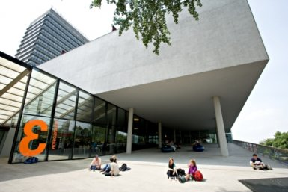
Course Structure
Lectures (2 per week)
Laboratories (1 per week)
  Submit exercises on Quarterfall
Q&A sessions (5 per week, optional)
4 group projects
Midterm and final exams

Slide 9

Suggested MO
Read lecture notes before class

Slide 10
Suggested MO
Read lecture notes before class
Ask questions during lecture

Slide 11
Suggested MO
Read lecture notes before class
Ask questions during lecture
Practice on MasteryGrids

Slide 12
Suggested Work Plan
Read lecture notes before class
Ask questions during lecture
Practice on MasteryGrids
Do exercises on Quarterfall

Slide 13
Q&A Sessions
Alec: Monday 17:15-19:00
Selim: Tuesday 9:15-11:00
Guanyi: Tuesday 15:15-17:00
Nathan: Thursday 15:15-17:00
Stefan: Friday 11:15-13:00
Francisca, Isaac, Pablo: by email or by appointment

Slide 14
Important Dates
16/2 – 2/3: group project 1
2/3 – 16/3: group project 2
18/3: midterm exam (on campus)
16/3 – 30/3: group project 3
30/3 – 15/4: group project 4
13/4: final exam (on campus)

Slide 15
Module 1:
Computational Thinking

Slide 16
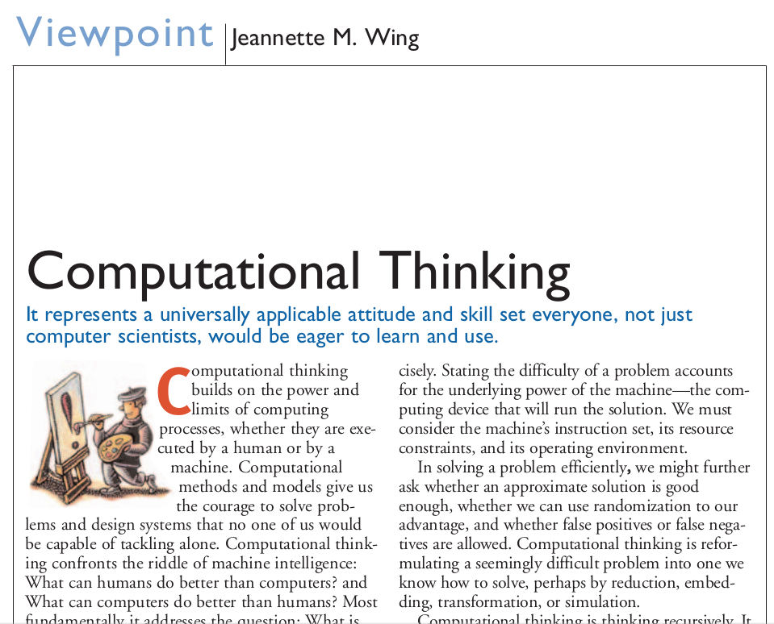
Module 1:
Computational Thinking

Slide 17
Giving Instructions
Take a piece of paper and a pen.
Draw a dot in the center of the page.
Draw a rectangle around the dot.
Write your name under the rectangle.

Slide 18
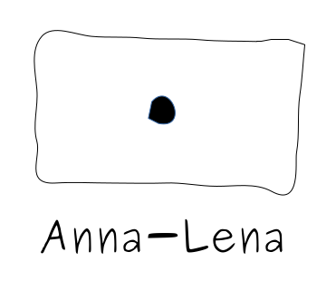
Giving Instructions
Take a piece of paper and a pen.
Draw a dot in the center of the page.
Draw a rectangle around the dot.
Write your name under the rectangle.
Pablo

Slide 19
Giving Instructions
Take a piece of paper and a pen.
Draw two dots close to each other.
Draw a short line.
Draw a U-shape.
Draw a circle around everything.

Slide 20
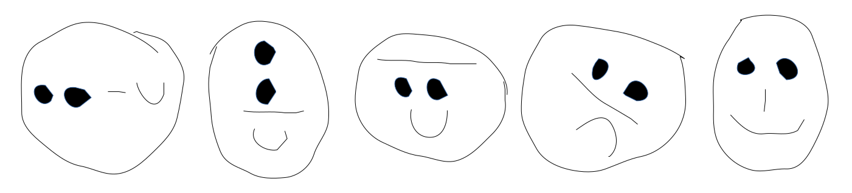
Giving Instructions
Take a piece of paper and a pen.
Draw two dots close to each other.
Draw a short line.
Draw a U-shape.
Draw a circle around everything.

Slide 21

Giving Instructions

Slide 22
Giving Instructions
1. forward(x)
2. left(x)
3. right(x)
4. jump(x,y)

Slide 23
Giving Instructions
forward(100)
jump(0,0)
left(45)
forward(100)
jump(0,0)
left(45)
forward(100)
jump(0,0)
left(45)
forward(100)
jump(0,0)
left(45)
forward(100)

Slide 24
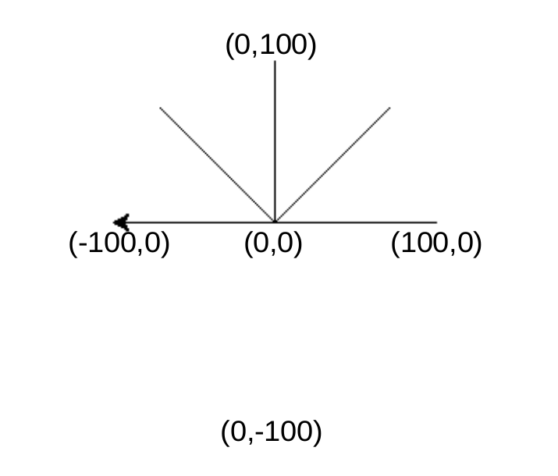
Giving Instructions
forward(100)
jump(0,0)
left(45)
forward(100)
jump(0,0)
left(45)
forward(100)
jump(0,0)
left(45)
forward(100)
jump(0,0)
left(45)
forward(100)

Slide 25
Giving Instructions
(0,10)
(10,10)
(0,0)
(10,0)

Slide 26
Giving Instructions
(0,10)
(10,10)
forward(10)
left(90)
forward(10)
left(90)
forward(10)
left(90)
forward(10)
(0,0)
(10,0)

Slide 27
Giving Instructions
(0,0)

Slide 28
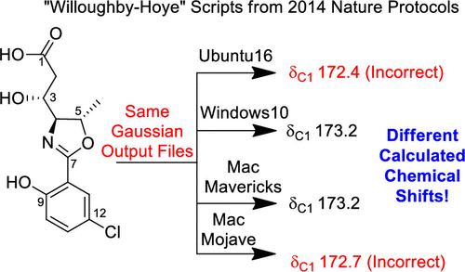
Giving Instructions
Org. Lett. 2019, 21, 20, 8449–8453

Slide 29
Exercise
forward(100)
left(120)
forward(100)
(0,0)
(0,0)
(0,0)

Slide 30
Exercise
forward(100)
left(120)
forward(100)
(0,0)
(0,0)
(0,0)

Slide 31
What’s next?
Laboratory group right after this lecture

Slide 32
What’s next?
Laboratory group right after this lecture
Submit laboratory exercises on Quarterfall

Slide 33
What’s next?
Laboratory group right after this lecture
Submit laboratory exercises on Quarterfall
Read lecture notes for next lecture on Blackboard

Slide 34
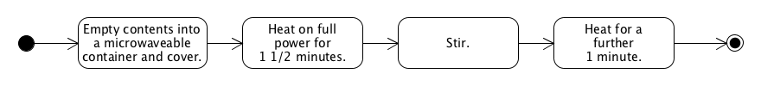
Next class
Activity Diagrams

